Slide 1
Blind estimation of acoustic transfer functions (ATFs) and dereverberation based on convolutive transfer functions (CTFs) Date：2024. 04. 24
Telecom Electroacoustics Audio(TEA) Lab
Presenter:
Anchi Yuan
Notes:
Hello everyone
I’m today’s presenter siang. I’m going to share some of my present work in source separation problem. My topic is comparative studies of source separation using semi-blind and blind source separation approaches.

Slide 2
Outline
Localization procedure
Simulation setting
Simulatio result

Slide 3
Localization procedure
Freefield plane wave model for MPDR angle-wise localization
Check array output power of UCA has global maximum or not
Array output power as objective function for golden section search method (GSS)
Freefield point source model for MUSIC distance-wise localization
Check pseudo-spectrum magnitude of sparce array has local maximum or not
pseudo-spectrum magnitude as objective function for golden section search method (GSS)

Slide 4
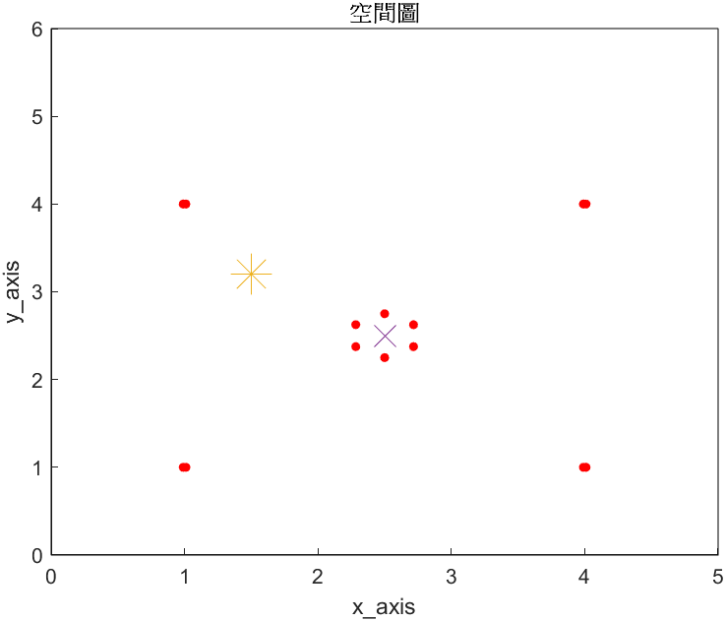




Simulation setting
Suppose that all elements in same height (Z-axis)
Suppose source is located in range of sparce array
Number of microphones = 8+6=14
Sparce array spacing = 0.02m (2cm)
UCA aperture = 0.5m
Room size = 5m $×$6m $×$2.5m
Sampling frequency = 16kHz
Reverberation time T₆₀ = 0.2s
Y-axis (m)
Source
Mics
Array center
X-axis (m)

Slide 5
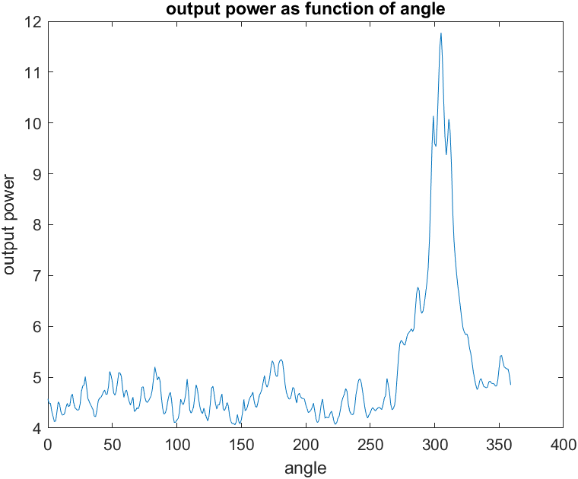
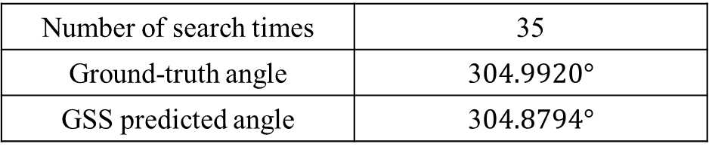
Simulation result (angle)
Number of search times | 35
Ground-truth angle | 3$04.9920°$
GSS predicted angle | 3$04.8794°$

Slide 6
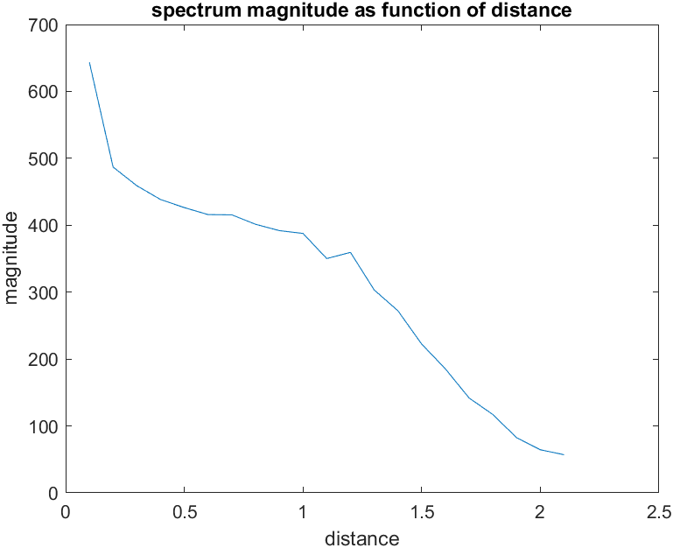
Simulation result (distance)
Number of search times | 31
Ground-truth angle | 1.2207 m
GSS predicted angle | 1.2214 m

Slide 7
